Slide 2
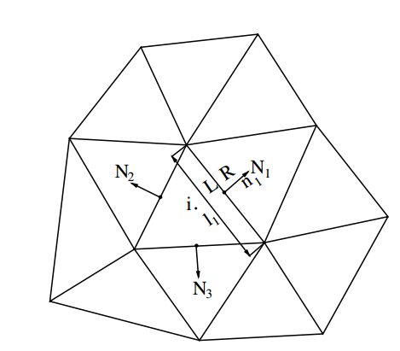

Slide 3
The i^{th} cell equation
i^{th} row
N₁th column
i^{th} row
i^{th} column
i^{th} row
N₂th column
i^{th} row
N₃th column
i^{th} row

Slide 4
The i^{th} cell equation
i^{th} row
N₁th column
i^{th} row
i^{th} column
i^{th} row
N₂th column
i^{th} row
N₃th column

Slide 5
The i^{th} cell equation
i^{th} row
N₁th column
i^{th} row
i^{th} column
i^{th} row
N₂th column
i^{th} row
N₃th column

Slide 6
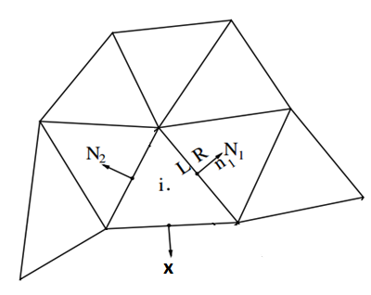

Slide 7
The i^{th} cell equation
i^{th} row
N₁th column
i^{th} row
i^{th} column
i^{th} row
N₂th column
i^{th} row
N₃th column
i^{th} row

Slide 8
The i^{th} cell equation using LUSGS scheme

Slide 9
The i^{th} cell equation
i^{th} row
N₁th column
i^{th} row
i^{th} column
i^{th} row
N₂th column
i^{th} row
N₃th column
i^{th} row

Slide 10
The i^{th} cell equation
i^{th} row
N₁th column
i^{th} row
i^{th} column
i^{th} row
N₂th column
i^{th} row
N₃th column

Slide 11
The i^{th} cell equation
i^{th} row
N₁th column
i^{th} row
i^{th} column
i^{th} row
N₂th column
i^{th} row
N₃th column

Slide 12
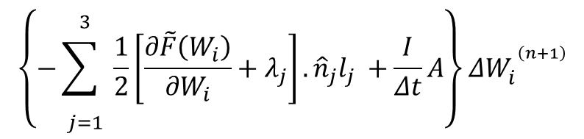
i^{th} row
N₁th column
i^{th} row
i^{th} column
i^{th} row
N₂th column
i^{th} row
N₃th column
$$\left\{−\overset{3}{\underset{j=1}{\sum{ }}}\frac{1}{2}\left[\frac{∂\tilde{F}\left(W_{i}\right)}{∂W_{i}}+λ_{j}\right].{\hat{n}}_{j}l_{j} +\frac{I}{Δt}A\right\}ΔW_{i}^{ ^{\left(n+1\right)}}$$

Slide 14
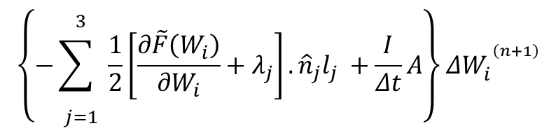
In forward sweep:
Just D is unknown and all L submatrix component have already computed
i^{th} row
N₁th column
i^{th} row
i^{th} column
$$\left\{−\overset{3}{\underset{j=1}{\sum{ }}}\frac{1}{2}\left[\frac{∂\tilde{F}\left(W_{i}\right)}{∂W_{i}}+λ_{j}\right].{\hat{n}}_{j}l_{j} +\frac{I}{Δt}A\right\}ΔW_{i}^{ ^{\left(n+1\right)}}$$

Slide 15
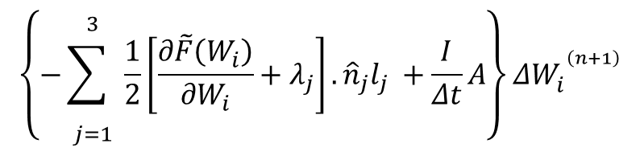
In Backward sweep:
Just D is unknown and all U submatrix component have already computed
i^{th} row
i^{th} column
i^{th} row
N₂th column
i^{th} row
N₃th column
$$\left\{−\overset{3}{\underset{j=1}{\sum{ }}}\frac{1}{2}\left[\frac{∂\tilde{F}\left(W_{i}\right)}{∂W_{i}}+λ_{j}\right].{\hat{n}}_{j}l_{j} +\frac{I}{Δt}A\right\}ΔW_{i}^{ ^{\left(n+1\right)}}$$

